Slide 1
Support Vector Machine
Lei Qian, Ph.D.

Slide 2
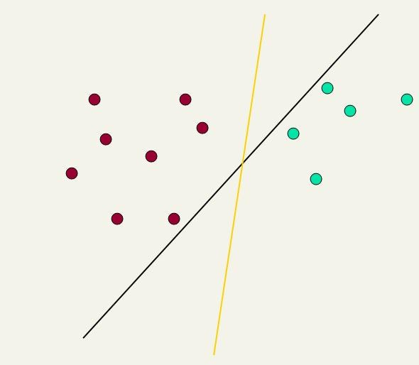
Linear classifiers: Which Hyperplane?
Ch. 15
This line represents the decision boundary:
ax + by − c = 0
Lots of possible solutions for a, b, c.
Some methods find a separating hyperplane, but not the optimal one
E.g., perceptron
Support Vector Machine (SVM) finds an optimal solution.
Maximizes the distance between the hyperplane and the “difficult points” close to decision boundary
One intuition: if there are no points near the decision surface, then there are no very uncertain classification decisions
Notes:
But note that Naïve Bayes also finds an optimal solution … just under a different definition of optimality.

Slide 3
Another intuition
Sec. 15.1
If you have to place a fat separator between classes, you have less choices, and so the capacity of the model has been decreased

Slide 4
Support Vector Machine (SVM)
Sec. 15.1
Support vectors
SVMs maximize the margin around the separating hyperplane.
A.k.a. large margin classifiers
The decision function is fully specified by a subset of training samples, the support vectors.
Solving SVMs is a quadratic programming problem
Maximizes
margin
Narrower
margin

Slide 5
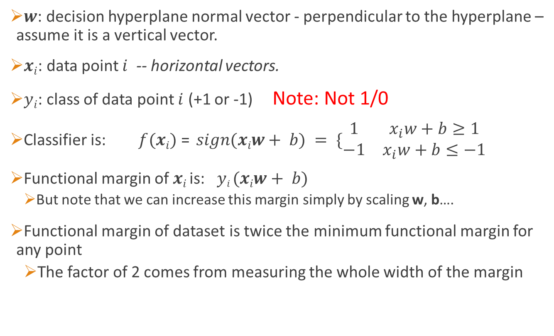
Maximum Margin: Formalization
Sec. 15.1
$w$: decision hyperplane normal vector - perpendicular to the hyperplane – assume it is a vertical vector.
$xi$: data point $i$ -- horizontal vectors.
$yi$: class of data point $i$ (+1 or -1) Note: Not 1/0
Classifier is: $f(xi)$ = $sign(xiw+ b) = \{\begin{matrix}1 & x_{i}w+b≥1 \\ −1 & x_{i}w+b≤−1\end{matrix}$
Functional margin of $xi$ is: $yi (xiw+ b)$
But note that we can increase this margin simply by scaling w, b….
Functional margin of dataset is twice the minimum functional margin for any point
The factor of 2 comes from measuring the whole width of the margin

Slide 6





Geometric Margin
Sec. 15.1
Distance from example to the separator is $r=\frac{y\left(xw+b\right)}{|\left|w|\right|}$
Examples closest to the hyperplane are support vectors.
Margin ρ of the separator is the width of separation between support vectors of classes.
$$x$$
ρ
$$r$$
$$x′$$
$$w$$
Notes:
Looking for distance r. Dotted line x’-x is perpendicular to decision boundary so parallel to w. Unit vector is w/|w|, so this one is rw/|w|.
x’ = x – rw/|w|. X’ satisfies wx+b = 0.
So wT(x –rw/|w|) + b = 0
Recall that |w| = sqrt(wTw). So, solving for r gives:
r = y(wTx + b)/|w|

Slide 7


Geometric Margin
Sec. 15.1
Distance from example to the separator is $r=\frac{y\left(xw+b\right)}{|\left|w|\right|}$
$$x$$
ρ
Derivation of finding r:
The dotted line $x′−x$ is perpendicular to
decision boundary so parallel to $w^{T}$.
Unit vector is $w^{T}/‖w‖$, so the dotted line, $x−x^{′}=yrw^{T}/‖w‖$. Therefore
$$x^{′}=x−yrw^{T}/‖w‖$$
But $x′$ satisfies $x′w+b$= 0.
So $(x –yrw^{T}/‖w‖)w + b = 0$
Recall that ${‖w‖}^{2}= wTw$.
So $xw –yr‖w‖+ b = 0$
Solving for $r$ gives:
$r = y(xw + b)/‖w‖$(note $y=1 or −1$)
$$r$$
$$x′$$
$$w$$
Notes:
Looking for distance r. Dotted line x’-x is perpendicular to decision boundary so parallel to w. Unit vector is w/|w|, so this one is rw/|w|.
x’ = x – rw/|w|. X’ satisfies wx+b = 0.
So wT(x –rw/|w|) + b = 0
Recall that |w| = sqrt(wTw). So, solving for r gives:
r = y(wTx + b)/|w|

Slide 8
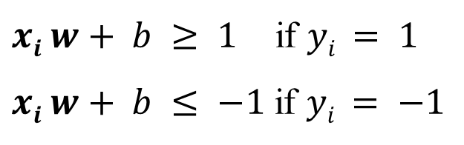
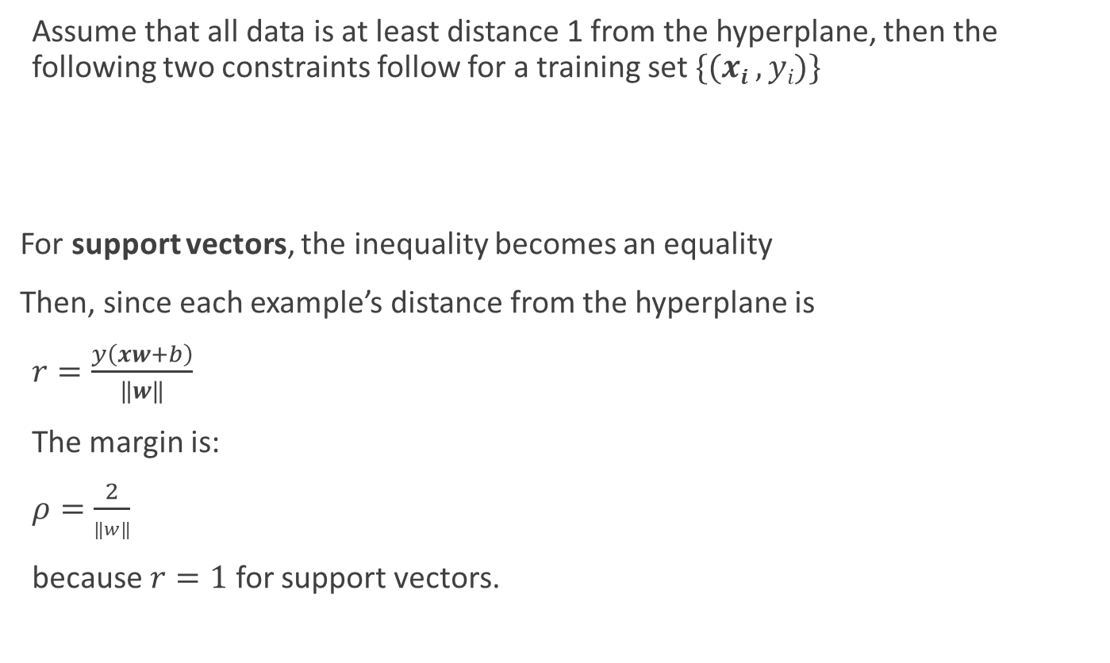
Linear SVM Mathematically The linearly separable case
Sec. 15.1
Assume that all data is at least distance 1 from the hyperplane, then the following two constraints follow for a training set $\{(xi ,yi)\}$
For support vectors, the inequality becomes an equality
Then, since each example’s distance from the hyperplane is
$r=\frac{y\left(xw+b\right)}{‖w‖}$
The margin is:
$ρ=\frac{2}{‖w‖}$
because $r=1$ for support vectors.
$xi w+ b ≥ 1$ if $yi = 1$
$xi w+ b ≤ −1$ if $yi = −1$

Slide 9




Linear Support Vector Machine (SVM)
Sec. 15.1
ρ
$$x_{q}w + b = 1$$
Hyperplane
$xw + b = 0$
Extra scale constraint:
$min_{i=1…n} |xi w+ b| = 1$
This implies:
$\left(x_{q}–xp\right)w = 2$
$ρ ={\left\|x_{q}−x_{p}\right\|}_{2} = 2/||w||2$
$$x_{p}w + b = −1$$
$$xw + b = 0$$

Slide 10

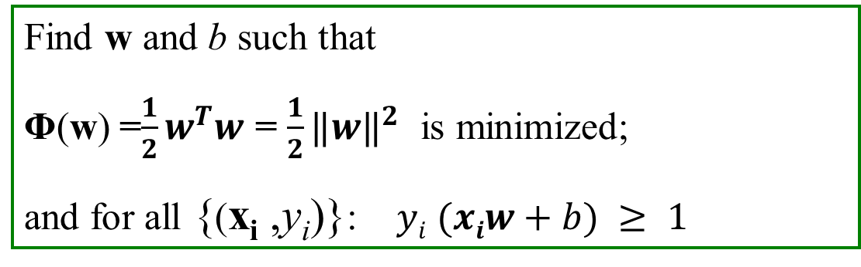
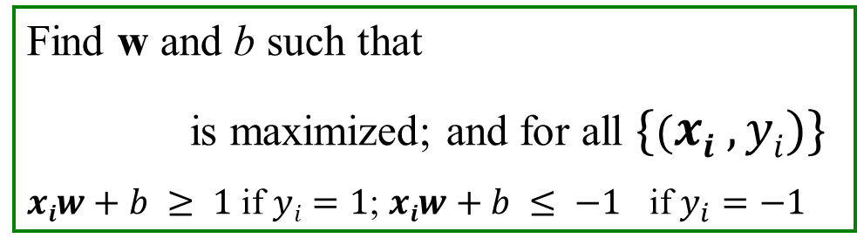
Linear SVMs Mathematically (cont.)
Sec. 15.1
Then we can formulate the quadratic optimization problem:
A better formulation (min $‖w‖$= max 1/ $‖w‖$):
Find w and b such that
is maximized; and for all $\{(xi , yi)\}$
$xiw+b ≥ 1$ if $yi=1$; $xiw+b ≤ −1$ if $y_{i}=−1$
Find w and b such that
Φ(w) =$\frac{1}{2}w^{T}w$ = $\frac{1}{2}{‖w‖}^{2}$ is minimized;
and for all {(x_{i} ,y_{i})}: $yi (xiw+b) ≥ 1$

Slide 11
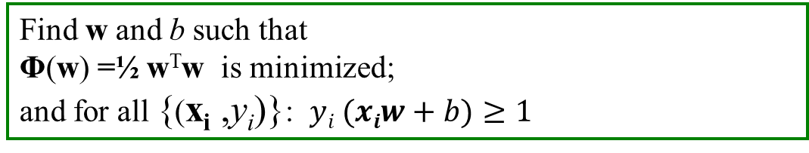
Solving the Optimization Problem
Sec. 15.1
This is now optimizing a quadratic function subject to linear constraints
Quadratic optimization problems are a well-known class of mathematical programming problem, and many (intricate) algorithms exist for solving them (with many special ones built for SVMs)
The solution involves constructing a dual problem where a Lagrange multiplier α_{i} is associated with every constraint in the primary problem
Find w and b such that
Φ(w) =½ w^{T}w is minimized;
and for all {(x_{i} ,y_{i})}: $yi (xiw+b)≥1$

Slide 12
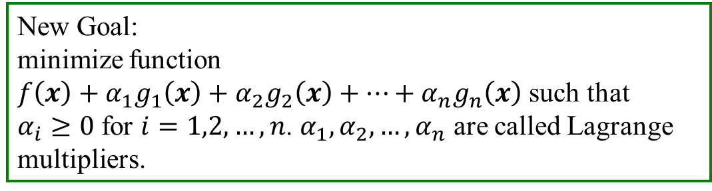
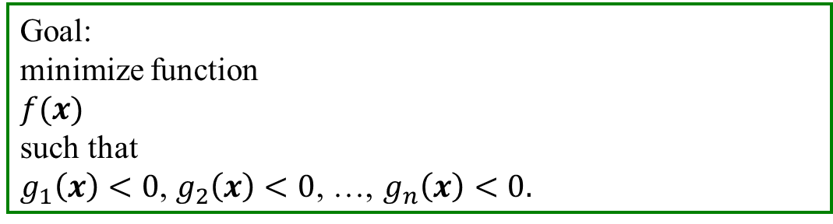
An Introduction to Lagrange Multipliers
Sec. 15.1
Goal:
minimize function
$f(x)$
such that
$g_{1}\left(x\right)<0$, $g_{2}\left(x\right)<0$, …, $g_{n}\left(x\right)<0.$
New Goal:
minimize function
$f\left(x\right)+α_{1}g_{1}\left(x\right)+α_{2}g_{2}\left(x\right)+…+α_{n}g_{n}\left(x\right)$ such that
$α_{i}≥0$ for $i=1,2,…,n$. $α_{1}, α_{2},…,α_{n}$ are called Lagrange multipliers.

Slide 13

Solving the Optimization Problem
Quadratic programming
with linear constraints
s.t.
$$yi (xiw+b)≥1$$
Lagrangian
Function
minimize $L_{p}\left(w,b, α_{i}\right)=\frac{1}{2}{\left|w\right|}^{2}−Σ_{i=1}^{n}α_{i}(y_{i}\left(x_{i}w+b\right)−1)$
s.t.

Slide 14

Solving the Optimization Problem
minimize $L_{p}\left(w,b, α_{i}\right)=\frac{1}{2}{\left|w\right|}^{2}−Σ_{i=1}^{n}α_{i}(y_{i}\left(x_{i}w+b\right)−1)$
s.t.
$$w=Σ_{i=1}^{n}α_{i}y_{i}x_{i}^{T}$$

Slide 15
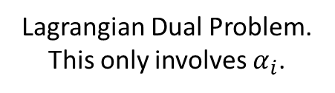

Solving the Optimization Problem
minimize $L_{p}\left(w,b, α_{i}\right)=\frac{1}{2}{\left|w\right|}^{2}−Σ_{i=1}^{n}α_{i}(y_{i}\left(x_{i}w+b\right)−1)$
s.t.
Lagrangian Dual Problem. This only involves $α_{i}$.
maximize $Σ_{i=1}^{n}α_{i}−\frac{1}{2}Σ_{i=1}^{n}Σ_{j=1}^{n}α_{i}α_{j}y_{i}y_{j}x_{i}x_{j}^{T}$
s.t.
, and

Slide 16
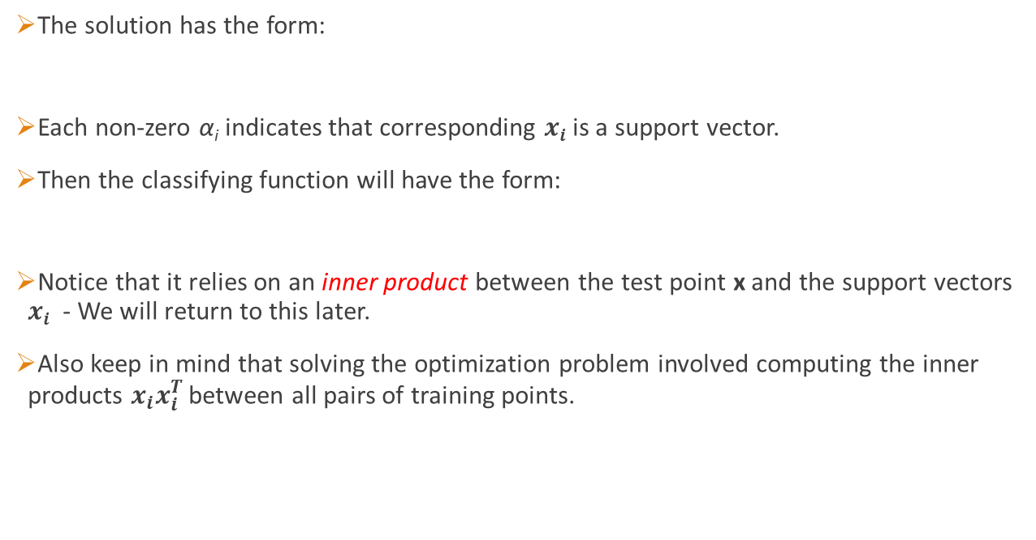

The Optimization Problem Solution
Sec. 15.1
The solution has the form:
Each non-zero α_{i} indicates that corresponding $xi$ is a support vector.
Then the classifying function will have the form:
Notice that it relies on an inner product between the test point x and the support vectors $xi$ - We will return to this later.
Also keep in mind that solving the optimization problem involved computing the inner products $x_{i}x_{i}^{T}$ between all pairs of training points.
$w=Σ_{i=1}^{n}αiyix_{i}^{T}$ $b=yk−xkw$ for any $xk$ such that $αk 0$
$$f\left(x\right)= Σαiyixx_{i}^{T}+ b$$

Slide 17
Soft Margin Classification
Sec. 15.2.1
If the training data is not linearly separable, slack variables ξ_{i} can be added to allow misclassification of difficult or noisy examples.
Allow some errors (also consider as avoiding overfitting)
Let some points be moved to where they belong, at a cost
Still, try to minimize training set errors, and to place hyperplane “far” from each class (large margin)
ξ_{i}
ξ_{j}

Slide 18
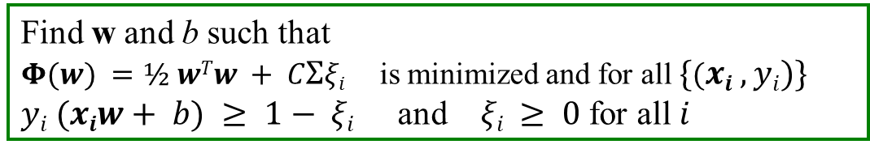
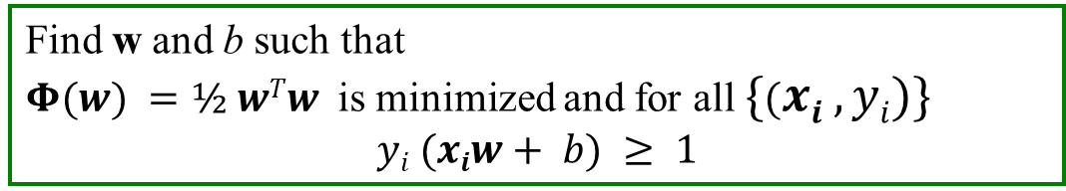
Soft Margin Classification Mathematically
Sec. 15.2.1
The old formulation:
The new formulation incorporating slack variables:
Parameter C can be viewed as a way to control overfitting
A regularization term
Find w and b such that
$Φ(w) =½ wTw$ is minimized and for all $\{(xi ,yi)\}$
$$yi (xiw+ b) ≥ 1$$
Find w and b such that
$Φ(w) =½ wTw + CΣξi$is minimized and for all $\{(xi ,yi)\}$
$yi (xiw+ b) ≥ 1− ξi$ and $ξi ≥ 0$ for all $i$

Slide 19
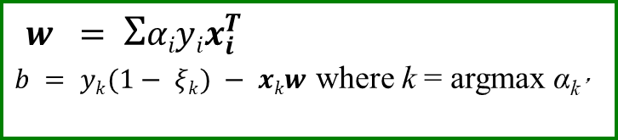
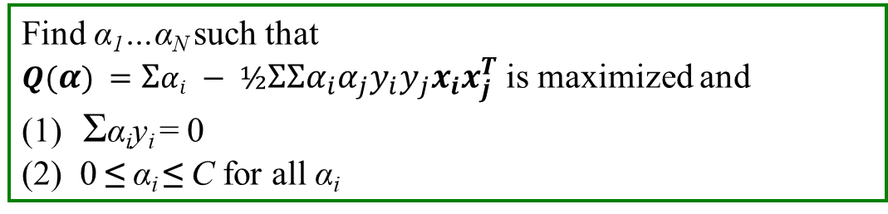


Soft Margin Classification – Solution
Sec. 15.2.1
The dual problem for soft margin classification:
Neither slack variables ξ_{i} nor their Lagrange multipliers appear in the dual problem!
Again, x_{i} with non-zero α_{i} will be support vectors.
Solution to the dual problem is:
Find α₁…α_{N} such that
$Q(α) =Σαi − ½ΣΣα_{i}α_{j}y_{i}y_{j}x_{i}x_{j}^{T}$ is maximized and
(1) Σα_{i}y_{i} = 0
(2) 0 ≤ α_{i} ≤ C for all α_{i}
$w$ is not needed explicitly for classification!
$w = Σαiyix_{i}^{T}$
$b = yk(1− ξk) − xkw$ where k = argmax α_{k’}
$$f(x) = Σαiyix x_{i}^{T}+ b$$
k’

Slide 20

Classification with SVMs
Sec. 15.1
Given a new point x, we can score its projection onto the hyperplane normal:
I.e., compute score: $xw + b = Σαiyixix_{i}^{T} + b$
Decide class based on whether < or > 0
Can set confidence threshold t.
Score > t : yes
Score < -t : no
Else: don’t know
1
0
-1

Slide 21

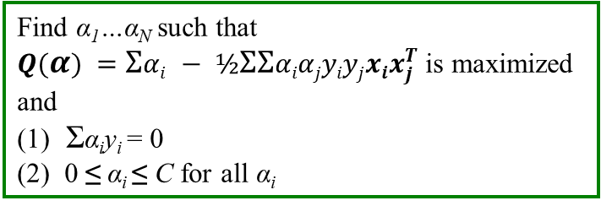
Linear SVMs: Summary
Sec. 15.2.1
The classifier is a separating hyperplane.
The most “important” training points are the support vectors; they define the hyperplane.
Quadratic optimization algorithms can identify which training points x_{i} are support vectors with non-zero Lagrangian multipliers α_{i}.
Both in the dual formulation of the problem and in the solution, training points appear only inside inner products:
Find α₁…α_{N} such that
$Q(α) =Σαi − ½ΣΣαiαjyiyjxix_{j}^{T}$is maximized and
(1) Σα_{i}y_{i} = 0
(2) 0 ≤ α_{i} ≤ C for all α_{i}
$$f(x) = Σαiyixx_{j}^{T} + b$$
Inner Product

Slide 22
Non-linear SVMs
Sec. 15.2.3
Datasets that are linearly separable (with some noise) work out great:
But what are we going to do if the dataset is just too hard?
How about … mapping data to a higher-dimensional space:
0
x
0
x
x²
0
x

Slide 23
Non-linear SVMs: Feature spaces
Sec. 15.2.3
General idea: the original feature space can always be mapped to some higher-dimensional feature space where the training set is separable:
Φ: x → φ(x)

Slide 24
The “Kernel Trick”
Sec. 15.2.3
Goal: Find w, b, {ξ_{i} , i=1…m} such that
Φ(w) =½ w^{T}w + CΣξ_{i} is minimized and for all {(x_{i} ,y_{i})}
y_{i} (x_{i}w + b) ≥ 1- ξ_{i} and ξ_{i} ≥ 0 for all i
Solution:
Find α₁…α_{N} such that
Q(α) =Σα_{i} - ½ΣΣα_{i}α_{j}y_{i}y_{j}x_{i}x_{j}^{T} is maximized and
(1) Σα_{i}y_{i} = 0
(2) 0 ≤ α_{i} ≤ C for all α_{i}
Predict function:
f(x) = Σα_{i}y_{i}xx_{i}^{T} + b

Slide 25
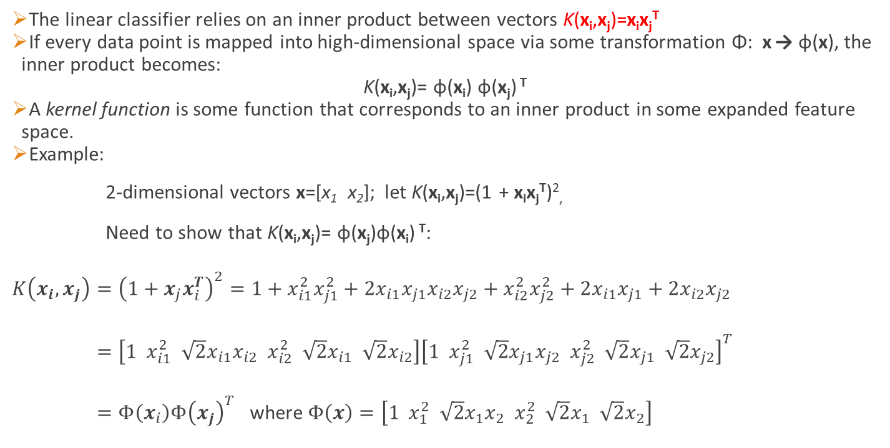
The “Kernel Trick”
Sec. 15.2.3
The linear classifier relies on an inner product between vectors K(x_{i},x_{j})=x_{i}x_{j}^{T}
If every data point is mapped into high-dimensional space via some transformation Φ: x → φ(x), the inner product becomes:
K(x_{i},x_{j})= φ(x_{i}) φ(x_{j}) ^{T}
A kernel function is some function that corresponds to an inner product in some expanded feature space.
Example:
2-dimensional vectors x=[x₁ x₂]; let K(x_{i},x_{j})=(1 + x_{i}x_{j}^{T})²,
Need to show that K(x_{i},x_{j})= φ(x_{j})φ(x_{i}) ^{T}:
$K\left(x_{i},x_{j}\right)={\left(1+x_{j}x_{i}^{T}\right)}^{2}=1+x_{i1}^{2}x_{j1}^{2}+2x_{i1}x_{j1}x_{i2}x_{j2}+x_{i2}^{2}x_{j2}^{2}+2x_{i1}x_{j1}+2x_{i2}x_{j2}$
$=\left[1 x_{i1}^{2} \sqrt{2}x_{i1}x_{i2} x_{i2}^{2} \sqrt{2}x_{i1} \sqrt{2}x_{i2}\right]{\left[1 x_{j1}^{2} \sqrt{2}x_{j1}x_{j2} x_{j2}^{2} \sqrt{2}x_{j1} \sqrt{2}x_{j2}\right]}^{T}$
$=Φ\left(x_{i}\right)Φ{\left(x_{j}\right)}^{T}$ where $Φ\left(x\right)=\left[1 x_{1}^{2} \sqrt{2}x_{1}x_{2} x_{2}^{2} \sqrt{2}x_{1} \sqrt{2}x_{2}\right]$

Slide 26
What Functions are Kernels?
For some functions K(x_{i},x_{j}) checking that K(x_{i},x_{j})= φ(x_{i}) φ(x_{j}) ^{T}can be cumbersome.
Mercer’s theorem:
Every semi-positive definite symmetric function is a kernel
Semi-positive definite symmetric functions correspond to a semi-positive definite symmetric Gram matrix:
K(x₁,x₁) | K(x₁,x₂) | K(x₁,x₃) | … | K(x₁,x_{N})
K(x₂,x₁) | K(x₂,x₂) | K(x₂,x₃) |  | K(x₂,x_{N})
… | … | … | … | …
K(x_{N},x₁) | K(x_{N},x₂) | K(x_{N},x₃) | … | K(x_{N},x_{N})
K=

Slide 27
Kernels
Sec. 15.2.3
Why use kernels?
Make non-separable problem separable.
Map data into better representational space
Common kernels
Linear: $K\left(x_{i},x_{j}\right)=x_{i}x_{j}^{T}$
Polynomial of power p: $K\left(x_{i},x_{j}\right)={\left(1+{x_{i}x}_{j}^{T}\right)}^{p}$
Gaussian (radial-basis function network, or RBF): $K\left(x_{i},x_{j}\right)=e^{−\frac{{\left\|x_{i}−x_{j}\right\|}^{2}}{2σ^{2}}}$
Sigmoid/Two-layer perceptron: $K\left(x_{i},x_{j}\right)=tanh(β_{0}x_{i}^{T}x_{j}+β_{1})$
(note that $tanh\left(x\right)=2g\left(2x\right)−1$ where $g\left(x\right)=\frac{1}{1+e^{−x}}$).
In practice, RBF (Gaussian) kernel works for most of problems.

Slide 28

Non-linear SVMs Mathematically
Dual problem formulation:
The solution is:
Optimization techniques for finding α_{i}’s remain the same!
Find $α_{1},⋯,α_{n}$ such that
$Q\left(α\right)=Σ_{i=1}^{n}α_{i}−\frac{1}{2}Σ_{i=1}^{n}Σ_{i=1}^{n}α_{i}α_{j}y_{i}y_{j}K(x_{i},x_{j})$ is maximized and
(1) $Σ_{i=1}^{n}α_{i}y_{i}=0$
(2) $0≤α_{i}≤C$ for all $α_{i}$
$$f\left(x\right)=Σ_{i∈SV}α_{i}K\left(x_{i},x\right)+b$$

Slide 29
Support Vector Machine: Algorithm
Choose a kernel function
Choose a value for C
Solve the quadratic programming problem (many software packages available)
Construct the discriminant function from the support vectors
Tuning SVMs remains a black art: selecting a specific kernel and parameters is usually done in a try-and-see manner.

Slide 30
Some Issues
Choice of kernel
- Gaussian or polynomial kernel is default
- if ineffective, more elaborate kernels are needed
- Choice of kernel parameters
- e.g. σ in Gaussian kernel
- σ is the distance between closest points with different classifications
- In the absence of reliable criteria, applications rely on the use of a validation set or cross-validation to set such parameters.
Optimization criterion – Hard margin v.s. Soft margin
- a lengthy series of experiments in which various parameters are tested

Slide 31
Summary: Support Vector Machine
1. Smaller C
Better generalization ability & less over-fitting
2. The Kernel Trick
Map data points to higher dimensional space in order to make them linearly separable.
Since only dot product is used, we do not need to represent the mapping explicitly.

Slide 32
Using SVM in Scikit-learn Machine Learning Package
Scikit-learn has several SVM classifier implementation:
SVC – General purpose SVM classifier.
NuSVC – Theoretically it is equivalent to SVC. The only difference is that SVC uses C parameter ($C≥0$) and NuSVC uses a Nu parameter which is between 0 and 1 ($nu∈(0,1]$). The parameter nu is an upper bound on the fraction of margin errors and a lower bound of the fraction of support vectors relative to the total number of training examples.
For example, if you set it to 0.05 you are likely to find at most 5% of your training examples being misclassified (at the cost of a small margin, though) and at least 5% of your training examples being support vectors.
SVR implements Support Vector Regression.
NuSVR is similar to SVR except it uses Nu parameter.
LinearSVC and LinearSVR are SVC and SVR that only use linear kernel.

Slide 33
Using SVM in Scikit-learn Machine Learning Package
SVM multi-class classification:
SVC and NuSVC implement the “one-vs-one” or “one-vs-rest” approach for multi- class classification.
If n_class is the number of classes, then n_class * (n_class - 1) / 2 classifiers are constructed and each one trains data from two classes.
LinearSVC implements “one-vs-rest” multi-class strategy, thus training n_class models.
Suggestion:
For classification problems, use NuSVC. If you believe the relation is linear, use LinearSVC.
Start with the default kernel (RBF), then try different kernels.

Slide 34
Using SVM in Scikit-learn Machine Learning Package
class sklearn.svm.NuSVC( nu=0.5, kernel='rbf', degree=3, gamma='auto', coef0=0.0, shrinking=True, probability=False, tol=0.001, cache_size=200, class_weight=None, verbose=False, max_iter=-1, random_state=None)
http://scikit-learn.org/stable/modules/generated/sklearn.svm.NuSVC.html#sklearn.svm.NuSVC
nu : float, optional (default=0.5). An upper bound on the fraction of training errors and a lower bound of the fraction of support vectors. Should be in the interval (0, 1].
kernel : string, optional (default=’rbf’). Specifies the kernel type to be used in the algorithm. It must be one of ‘linear’, ‘poly’, ‘rbf’, ‘sigmoid’, ‘precomputed’ or a callable. If none is given, ‘rbf’ will be used. If a callable is given it is used to precompute the kernel matrix.
degree : int, optional (default=3). Degree of the polynomial kernel function (‘poly’). Ignored by all other kernels.
gamma : float, optional (default=’auto’). Kernel coefficient for ‘rbf’, ‘poly’ and ‘sigmoid’. If gamma is ‘auto’ then 1/n_features will be used instead.

Slide 35
Using SVM in Scikit-learn Machine Learning Package
#You must install sklearn before you can use SVM package of sklearn.
import numpy as np
from sklearn.svm import SVC, NuSVC
clf = NuSVC(kernel='rbf' , nu=0.01, gamma=0.02) #Create an SVM.
clf.fit(Xtrn,Ytrn) #X is mXn array and Y is an mX1 array, where m is the number of samples
#and n is the number of features.
clf.predict(Xtst) # Perform classification on samples in Xtst.
clf.score(Xtst, Ytst) #Returns the mean accuracy on the given test data and labels.

Slide 36
Choose parameters
Margin Classifier C
The smaller the C, the better generalization ability & less over-fitting
Nu parameter
Smaller Nu causes less rate of misclassification for training data, therefore, may have more overfitting.
Gamma parameter
Intuitively, the gamma parameter defines how far the influence of a single training example reaches, with low values meaning ‘far’ and high values meaning ‘close’. The gamma parameters can be seen as the inverse of the radius of influence of samples selected by the model as support vectors.
Cross-validation set can be used to determine optimized Nu (or C) and gamma.

